Slide 1
Lecture 3: Database Design Entity-Relationship Model

Slide 2
Reading
Chapter 7
Sections 7.1 to 7.7
Please note that these set of slides is not comprehensive and reading Chapter 7 is required.

Slide 3
Chapter 7: Entity-Relationship Model
Design Process
Modeling
Constraints
E-R Diagram
Design Issues
Weak Entity Sets
Extended E-R Features
Reduction to Relation Schemas
Database Design

Slide 4
Design Phases
Needs of users are central to designing ERD and databases
Gather requirements
Build Entity Relationship diagram
Need to avoid
Redundancy
Incompleteness

Slide 5
Design Phases (Cont.)
The process of moving from an abstract data model to the implementation of the database proceeds in two final design phases.
Logical Design – Deciding on the database schema. Database design requires that we find a “good” collection of relation schemas.
Business decision – What attributes should we record in the database?
Computer Science decision – What relation schemas should we have and how should the attributes be distributed among the various relation schemas?
Physical Design – Deciding on the physical layout of the database
Notes:
5

Slide 6
Design Approaches
Entity Relationship Model (covered in this chapter)
Models an enterprise as a collection of entities and relationships
Entity: a “thing” or “object” in the enterprise that is distinguishable from other objects
Described by a set of attributes
Relationship: an association among several entities
Represented diagrammatically by an entity-relationship diagram:
Normalization Theory (Chapter 8)
Formalize what designs are bad, and test for them
Notes:
6

Slide 7
Outline of the ER Model

Slide 8
ER model -- Database Modeling
The ER data model was developed to facilitate database design by allowing specification of an enterprise schema that represents the overall logical structure of a database.
The ER model is very useful in mapping the meanings and interactions of real-world enterprises onto a conceptual schema. Because of this usefulness, many database-design tools draw on concepts from the ER model.
The ER data model employs three basic concepts:
entity sets,
relationship sets,
attributes.
The ER model also has an associated diagrammatic representation, the ER diagram, which can express the overall logical structure of a database graphically.

Slide 9
Database Modeling
A database can be modeled as:
A collection of entities, and
relationships among entities.
An entity is an object that exists and is distinguishable from other objects. An entity can be concrete or abstract.
Example: specific person, company, event, plant
Entities have attributes
Example: people have names and addresses
An entity set is a set of entities of the same type that share the same properties.
Example: set of all persons, companies, trees, holidays

Slide 10
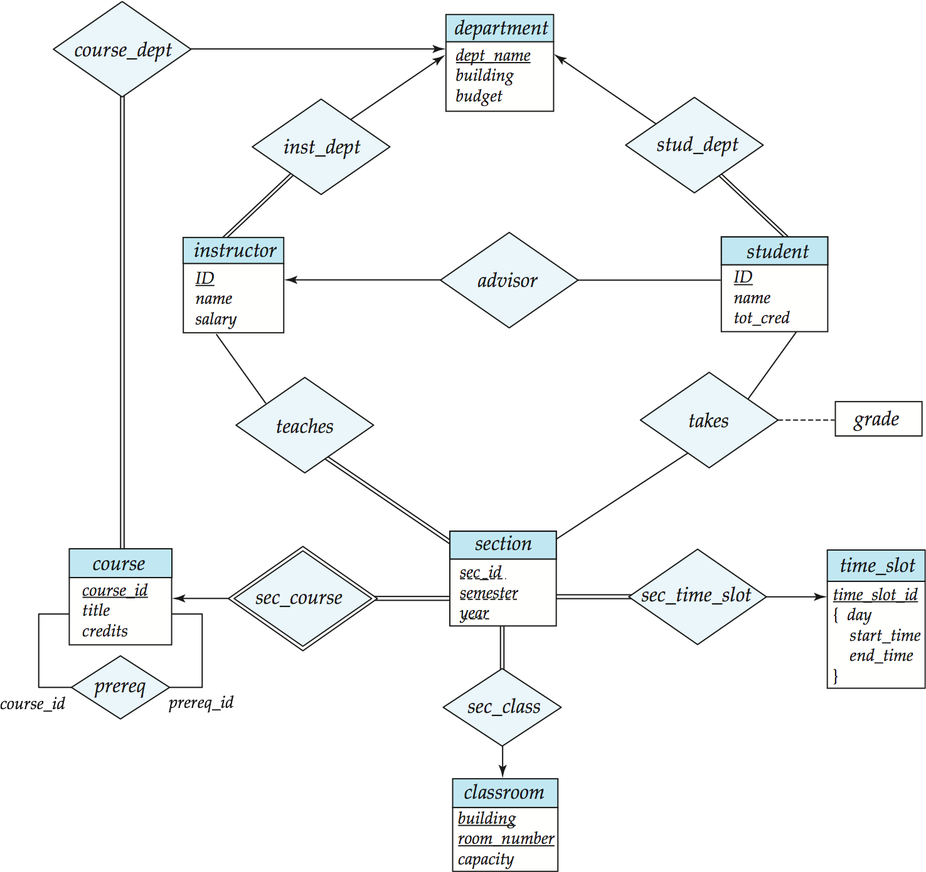
E-R Diagram for a University Enterprise

Slide 11
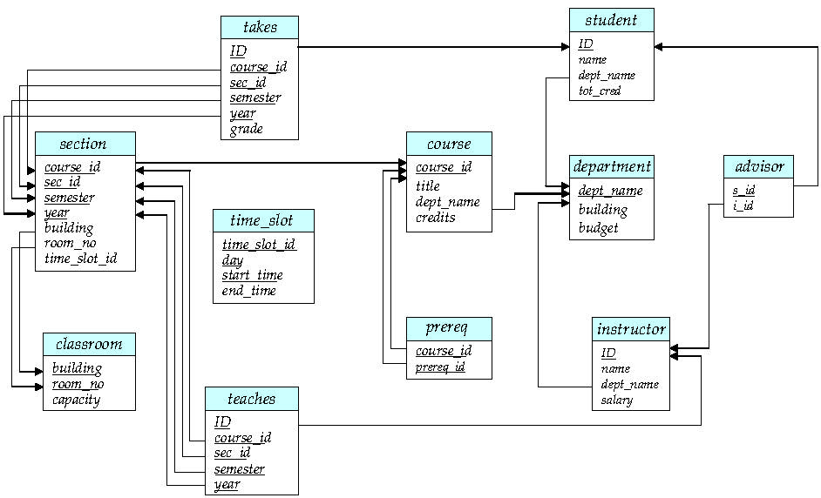
Schema Diagram for University Database

Slide 12
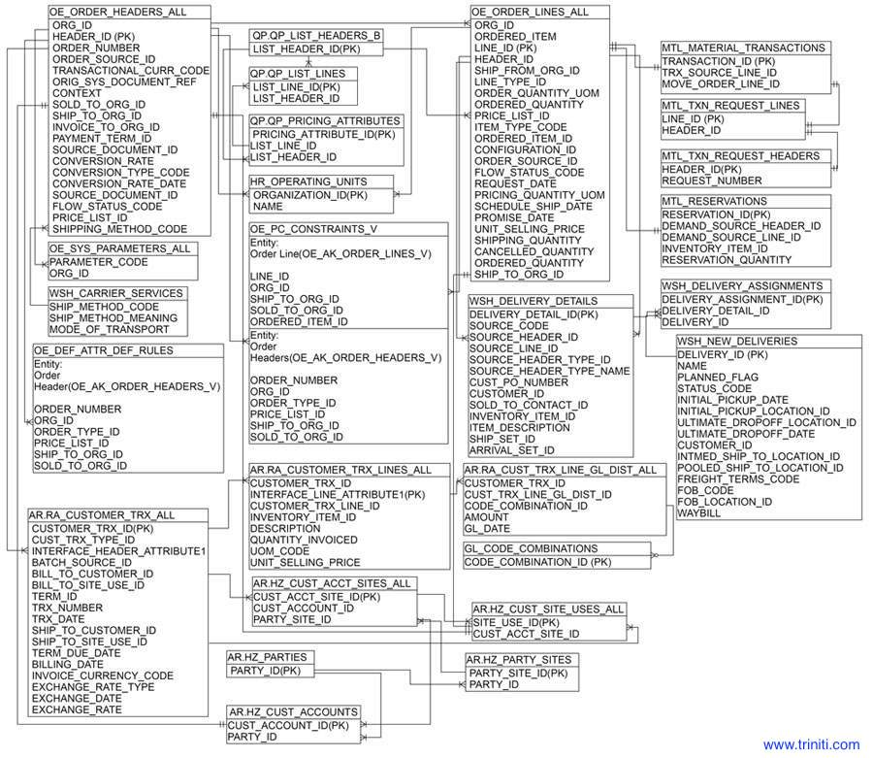

Order to Cash ER Diagram

Slide 13
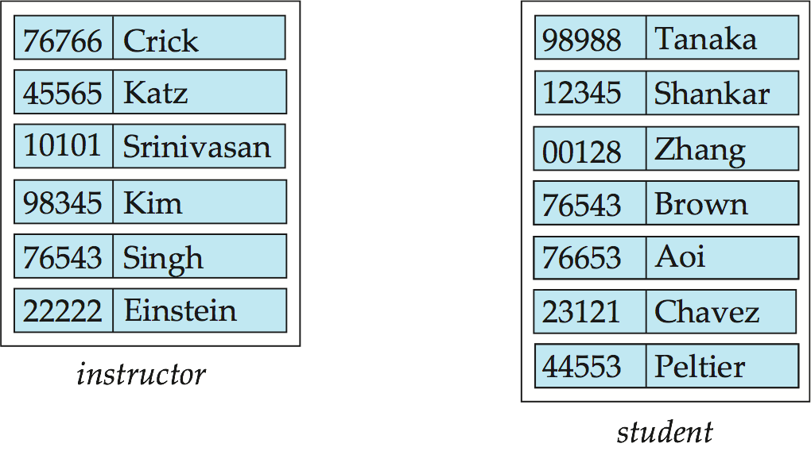
Entity Sets instructor and student
instructor_ID instructor_name student-ID student_name

Slide 14
Relationship Sets
A relationship is an association among several entities
Example: 44553 (Peltier) advisor 22222 (Einstein) student entity relationship set instructor entity
A relationship set is a mathematical relation among n ≥ 2 entities, each taken from entity sets
{(e₁, e₂, … e_{n}) | e₁ ∈ E₁, e₂ ∈ E₂, …, e_{n} ∈ E_{n}} where (e₁, e₂, …, e_{n}) is a relationship
Example:
(44553,22222) ∈ advisor

Slide 15
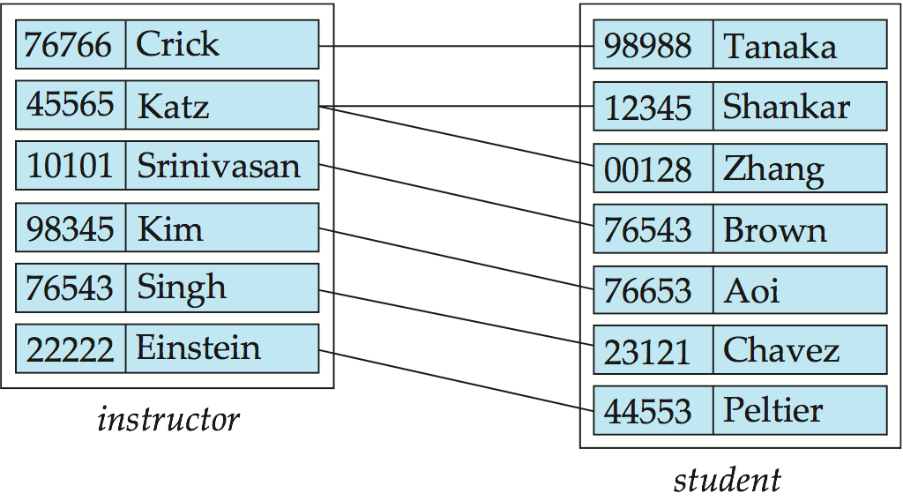
Relationship Set advisor

Slide 16
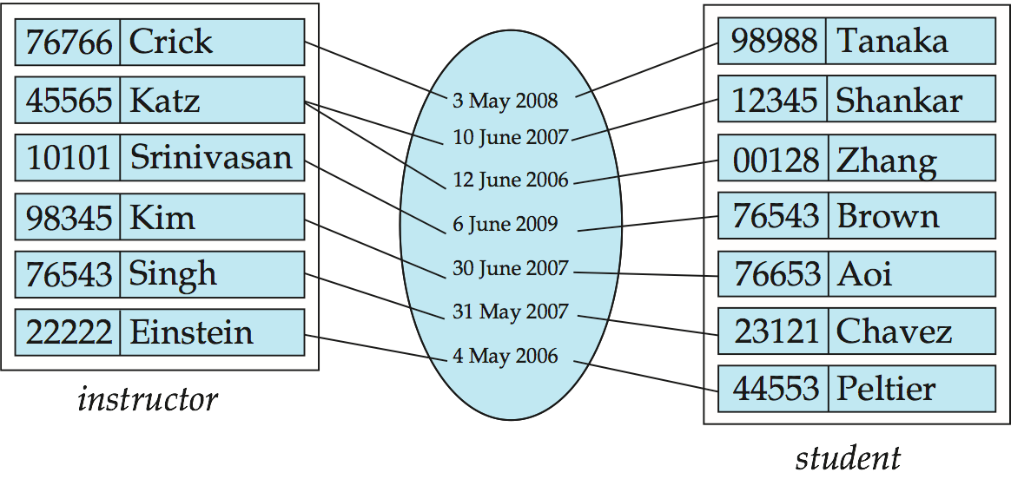
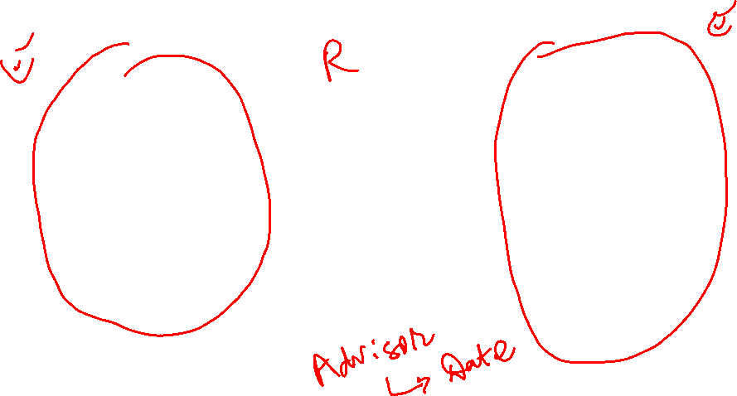
Relationship Sets (continued)
An attribute can also be property of a relationship set.
For instance, the advisor relationship set between entity sets instructor and student may have the attribute date which tracks when the student started being associated with the advisor

Slide 17
Degree of a Relationship Set
Binary Relationship
involve two entity sets
Most relationship sets in a database system are binary.
Relationships between more than two entity sets are rare.
Example: students work on research projects under the guidance of an instructor.
relationship proj_guide is a ternary (base of 3) relationship between instructor, student, and project

Slide 18
Attributes
An entity is represented by a set of attributes, that is descriptive properties possessed by all members of an entity set.
Example:
instructor = (ID, name, street, city, salary ) course= (course_id, title, credits)
Domain – the set of permitted values for each attribute
E.g. Semester: Fall, Winter, Spring, Summer
Attribute types:
Simple and composite attributes.
Single-valued and multivalued attributes
Example: multivalued attribute: phone_numbers
Derived attributes (Not stored but calculated)
Can be computed from other attributes
Example: age, given date_of_birth

Slide 19
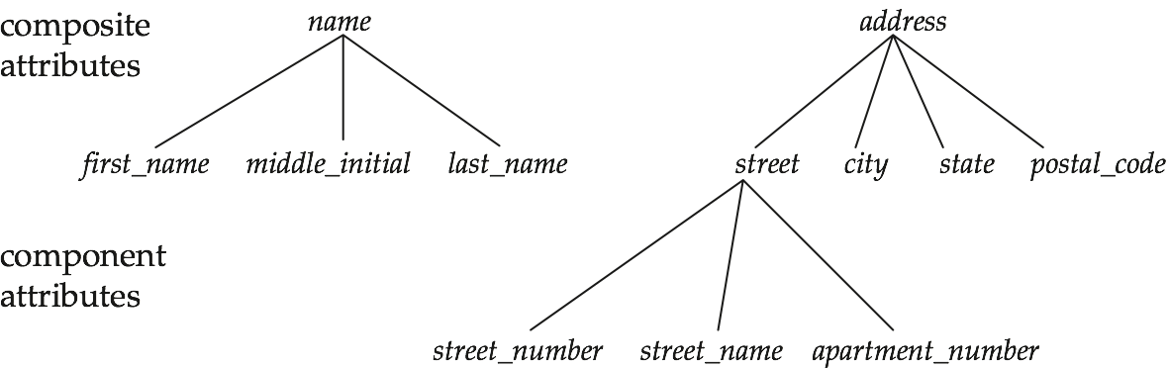

Composite Attributes

Slide 20
Redundant Attributes
Suppose we have entity sets:
instructor, with attributes: ID, name, dept_name, salary
department, with attributes: dept_name, building, budget
We model the fact that each instructor has an associated department using a relationship set inst_dept
The attribute dept_name appears in both entity sets. Since it is the primary key for the entity set department, it replicates information present in the relationship and is therefore redundant in the entity set instructor and needs to be removed.
BUT: when converting back to tables, in some cases the attribute gets reintroduced, as we will see later.

Slide 21
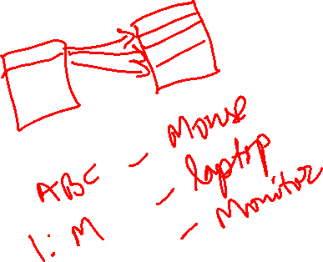
Mapping Cardinality Constraints
Expresses the number of entities to which another entity can be associated via a relationship set.
Most useful in describing binary relationship sets.
For a binary relationship set the mapping cardinality must be one of the following types:
One to one
One to many
Many to one
Many to many
E.g. Customer and Invoice (1:M)

Slide 22
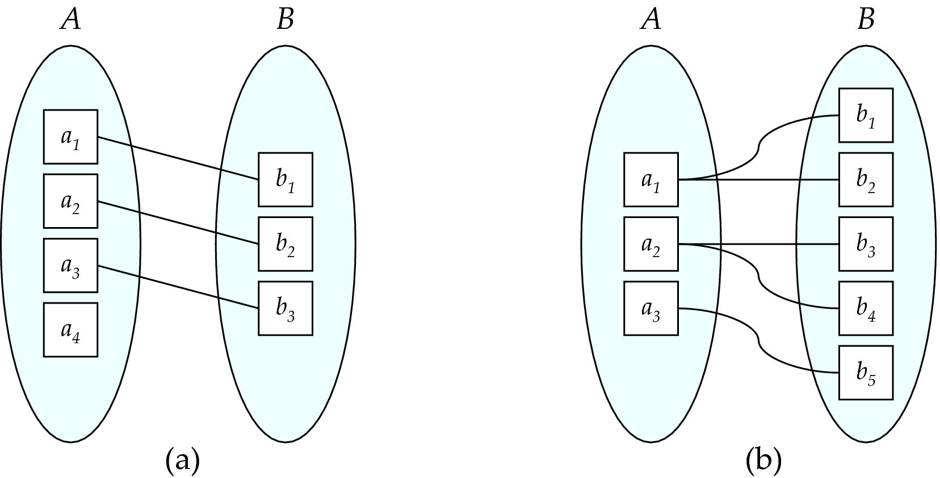
Mapping Cardinalities
One to one
One to many
Note: Some elements in A and B may not be mapped to any
elements in the other set

Slide 23
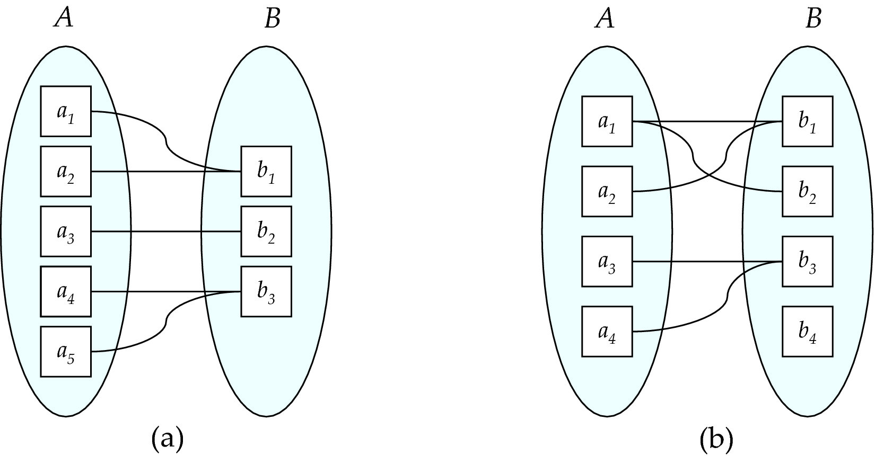
Mapping Cardinalities
Many to one
Many to many
Note: Some elements in A and B may not be mapped to any
elements in the other set

Slide 24
Keys
A super key of an entity set is a set of one or more attributes whose values uniquely determine each entity.
A candidate key of an entity set is a minimal super key
ID is candidate key of instructor
course_id is candidate key of course
Although several candidate keys may exist, one of the candidate keys is selected to be the primary key.

Slide 25
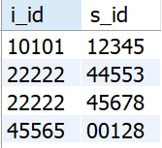
Keys for Relationship Sets
The combination of primary keys of the participating entity sets forms a super key of a relationship set.
(s_id, i_id) is the super key of advisor
NOTE: this means a pair of entity sets can have at most one relationship in a particular relationship set.
Must consider the mapping cardinality of the relationship set when deciding what are the candidate keys
Need to consider semantics of relationship set in selecting the primary key in case of more than one candidate key

Slide 26
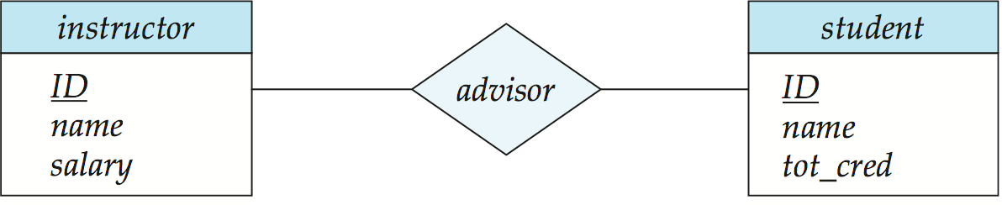
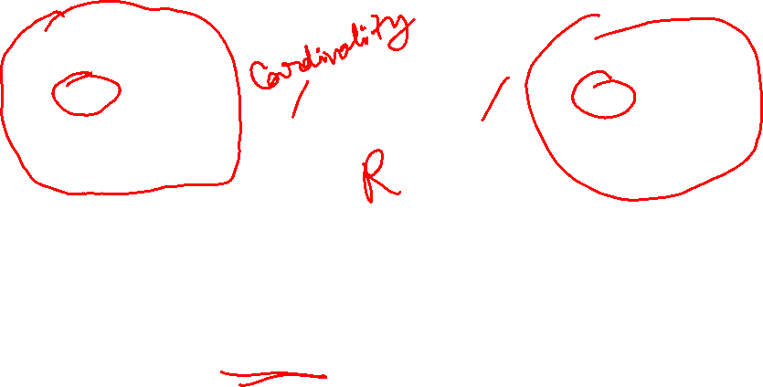
E-R Diagrams
Entity
Relationship
Entity
Rectangles represent entity sets.
Diamonds represent relationship sets.
Attributes are listed inside entity rectangle
Underline indicates primary key attributes

Slide 27
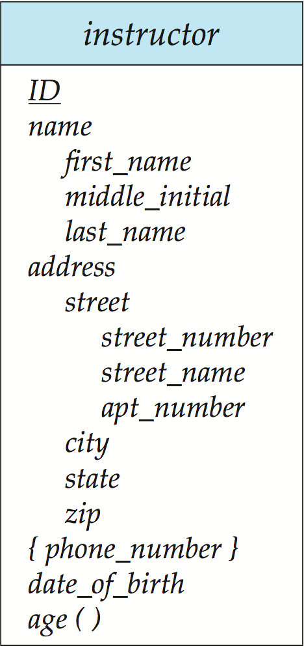
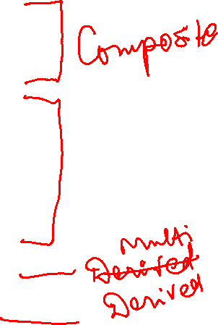
Entity With Composite, Multivalued, and Derived Attributes

Slide 28
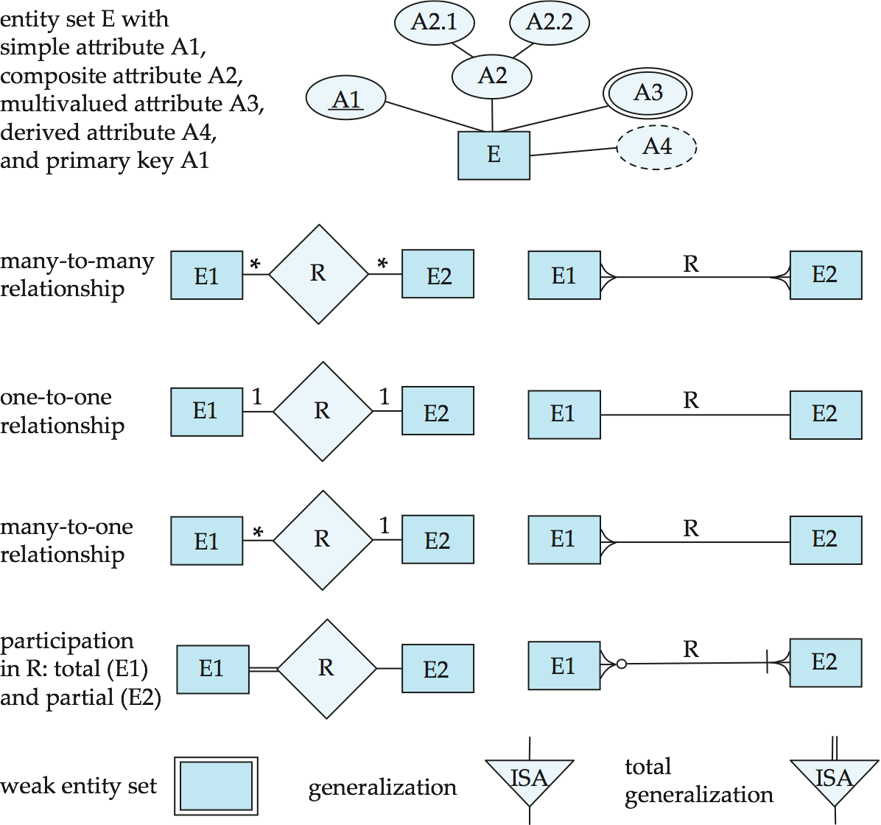
Alternate Notation

Slide 29
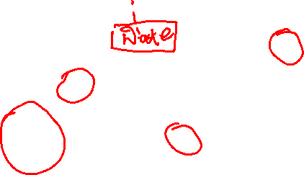
E-R Diagram for a University Enterprise

Slide 30
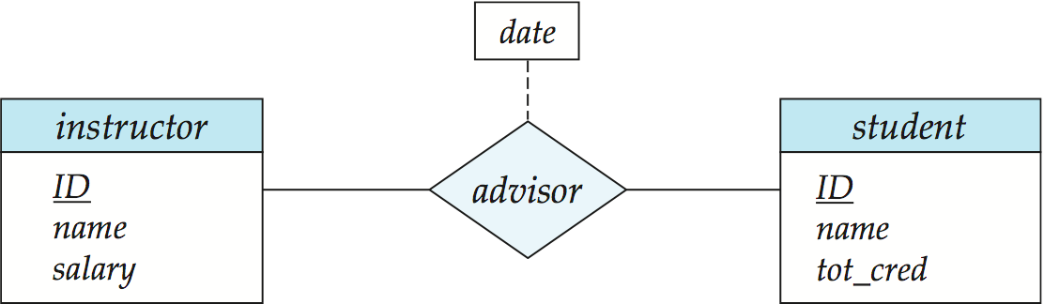

Relationship Sets with Attributes
Instructor ‘A’ advises student ‘AB’ during Fall 2018

Slide 31
Cardinality Constraints
We express cardinality constraints by drawing either a directed line (→), signifying “one,” or an undirected line (—), signifying “many,” between the relationship set and the entity set.
One-to-one relationship:
A student is associated with at most one instructor via the relationship advisor
A student is associated with at most one department via stud_dept
Note: Above statement is also known as a business rule

Slide 32
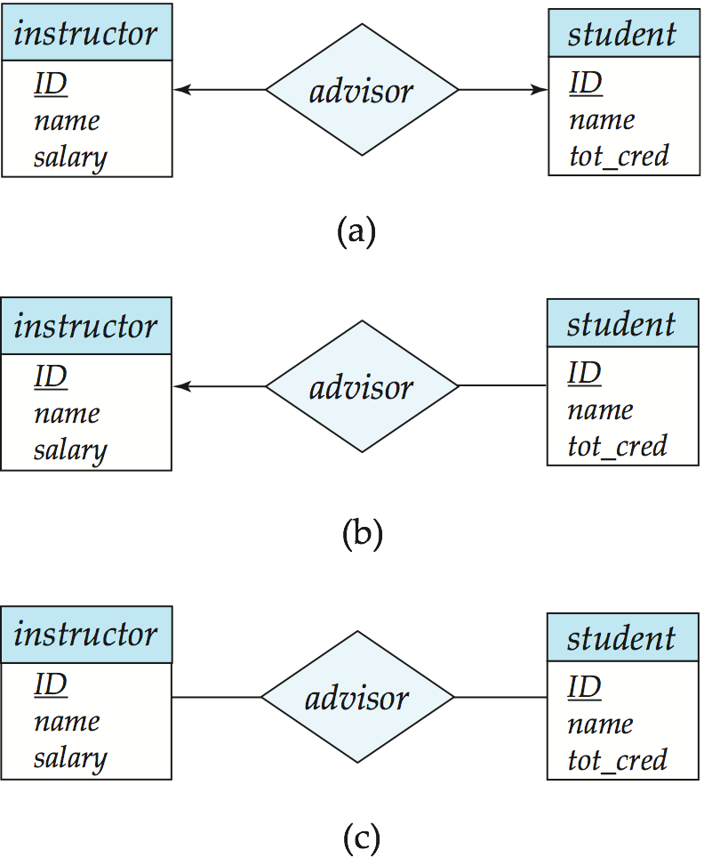
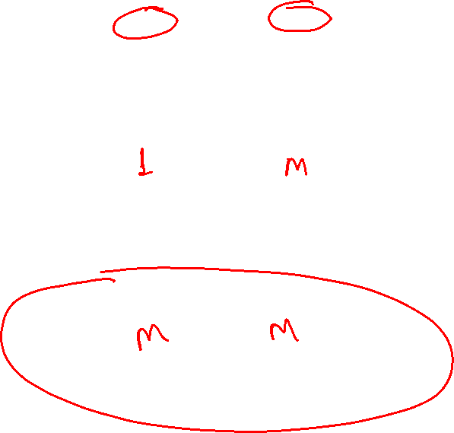
Figure 7.09
1:1
1:M
M:M

Slide 33
One-to-One Relationship
one-to-one relationship between an instructor and a student
an instructor is associated with at most one student via advisor
and a student is associated with at most one instructor via advisor

Slide 34
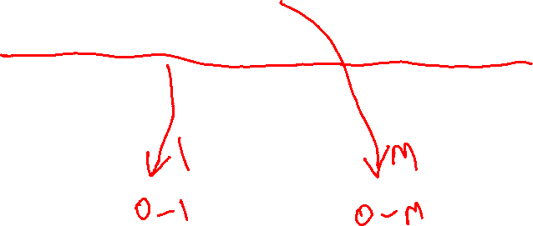
One-to-Many Relationship
one-to-many relationship between an instructor and a student
an instructor is associated with several (including 0) students via advisor (Business Rule)
a student is associated with at most one instructor via advisor (Business Rule)

Slide 35

Many-to-One Relationships
In a many-to-one relationship between an instructor and a student,
an instructor is associated with at most one student via advisor,
and a student is associated with several (including 0) instructors via advisor

Slide 36


Many-to-Many Relationship
An instructor is associated with several (possibly 0) students via advisor
A student is associated with several (possibly 0) instructors via advisor

Slide 37
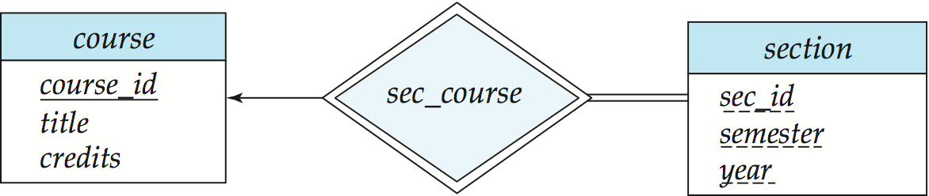
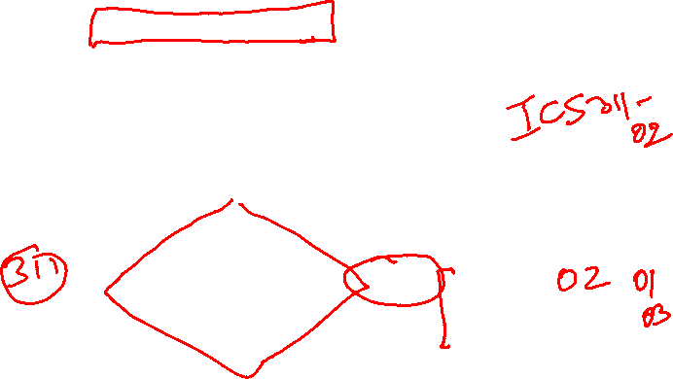
Participation of an Entity Set in a Relationship Set
Total participation (indicated by double line): every entity in the entity set participates in at least one relationship in the relationship set
E.g., participation of section in sec_course is total
every section must have an associated course
Partial participation: some entities may not participate in any relationship in the relationship set
Example: participation of instructor in advisor is partial

Slide 38

E-R Diagram for a University Enterprise

Slide 39
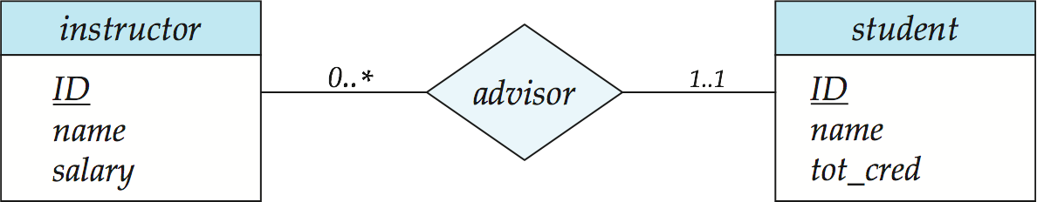
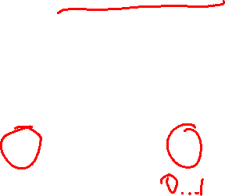
Notation for Expressing More Complex Constraints
A line may have an associated minimum and maximum cardinality, shown in the form l..h, where l is the minimum and h the maximum cardinality
A minimum value of 1 indicates total participation.
A maximum value of 1 indicates that the entity participates in at most one relationship
A maximum value of * indicates no limit.
Instructor can advise 0 or more students. A student must have 1 advisor; cannot have multiple advisors

Slide 40
Weak Entity Sets
An entity set that does not have sufficient attributes to form a primary key is referred to as a weak entity set.
The existence of a weak entity set depends on the existence of a identifying entity set
It must relate to the identifying entity set via a total, one-to-many relationship set from the identifying to the weak entity set
Identifying relationship is depicted using a double diamond
The discriminator (or partial key) of a weak entity set is the set of attributes that distinguishes among all the entities of a weak entity set.
The primary key of a weak entity set is formed by the primary key of the strong entity set on which the weak entity set is said to be existence dependent, plus the weak entity set’s discriminator.

Slide 41

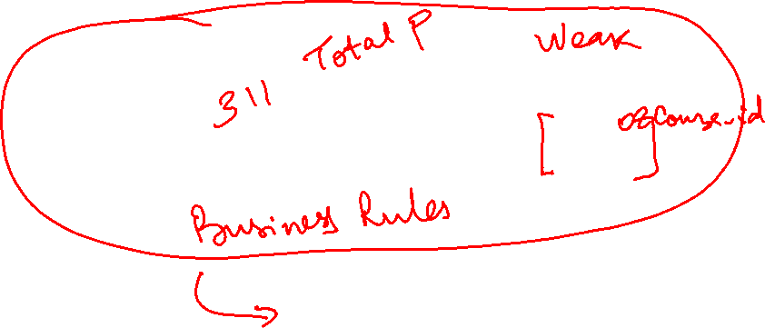
Weak Entity Sets (continued)
We underline the discriminator of a weak entity set with a dashed line.
We put the identifying relationship of a weak entity in a double diamond.
Primary key for section – (course_id, sec_id, semester, year)

Slide 42
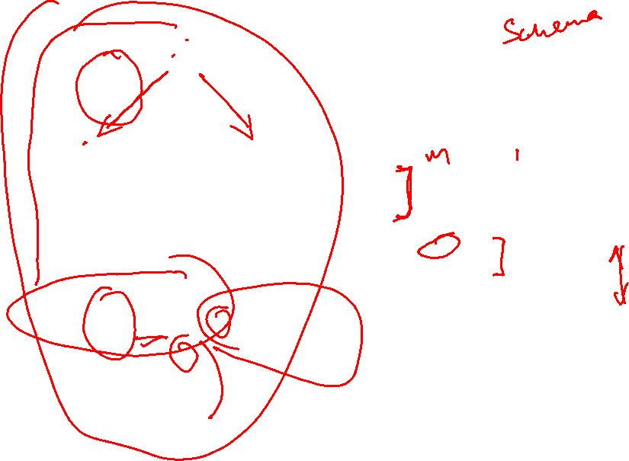
E-R Diagram for a University Enterprise

Slide 43
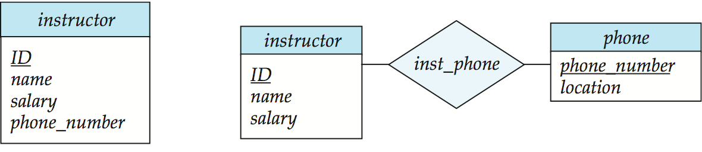

Design Issues
Use of entity sets vs. attributes
Use of phone as an entity allows extra information about phone numbers (plus multiple phone numbers)
Notes:
43

Slide 44
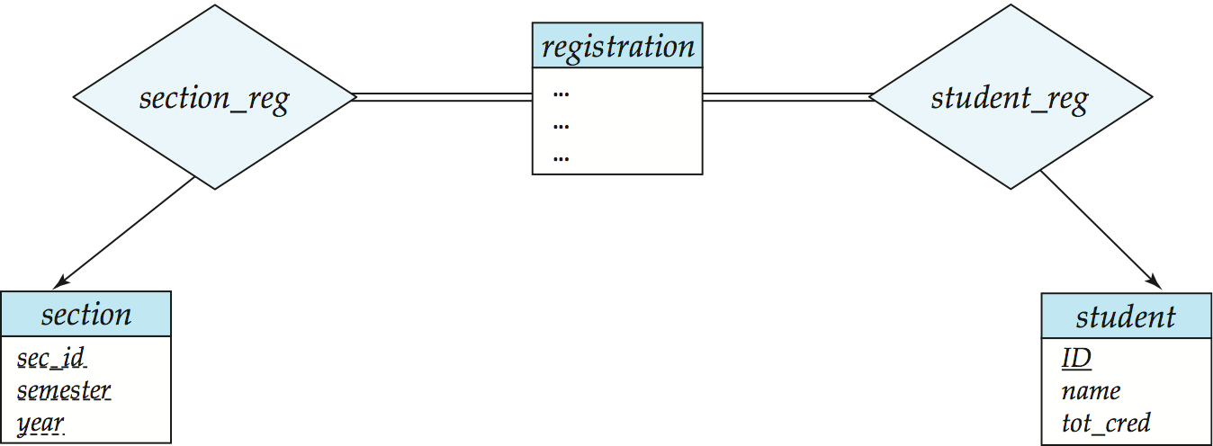

Design Issues
Use of entity sets vs. relationship sets Possible guideline is to designate a relationship set to describe an action that occurs between entities
Notes:
44

Slide 45
Design Issues
Binary versus n-ary relationship sets Although it is possible to replace any nonbinary (n-ary, or n > 2) relationship set by a number of distinct binary relationship sets, a n-ary relationship set shows more clearly that several entities participate in a single relationship.
e.g.
child-mother-father OR
child relates to mother/ child relates to father
Placement of relationship attributes
e.g., attribute date as attribute of advisor or as attribute of student
Notes:
45

Slide 46
E-R Design Decisions
The use of an attribute or entity set to represent an object.
Whether a real-world concept is best expressed by an entity set or a relationship set.
The use of a ternary relationship versus a pair of binary relationships.
The use of a strong or weak entity set.

Slide 47
Reduction to Relational Schemas

Slide 48
Reduction to Relation Schemas
Entity sets and relationship sets can be expressed uniformly as relation schemas that represent the contents of the database.
A database which conforms to an E-R diagram can be represented by a collection of schemas.
For each entity set and relationship set there is a unique schema that is assigned the name of the corresponding entity set or relationship set.
Each schema has a number of columns (generally corresponding to attributes), which have unique names.

Slide 49

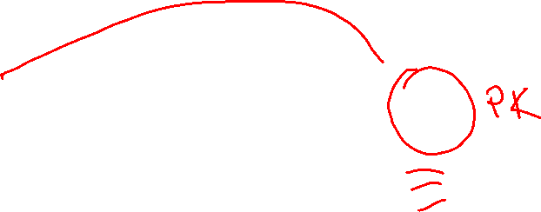
Representing Entity Sets With Simple Attributes
A strong entity set reduces to a schema with the same attributes student(ID, name, tot_cred)
A weak entity set becomes a table that includes a column for the primary key of the identifying strong entity set section ( course_id, sec_id, sem, year )

Slide 50

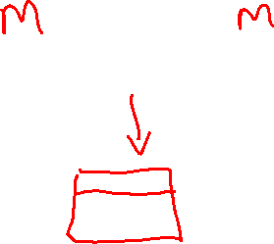
Mapping many-to-many Relationships
A many-to-many relationship set is represented as a schema with attributes for the primary keys of the two participating entity sets, and any descriptive attributes of the relationship set.
Example: schema for relationship set advisor
advisor = (s_id, i_id)

Slide 51
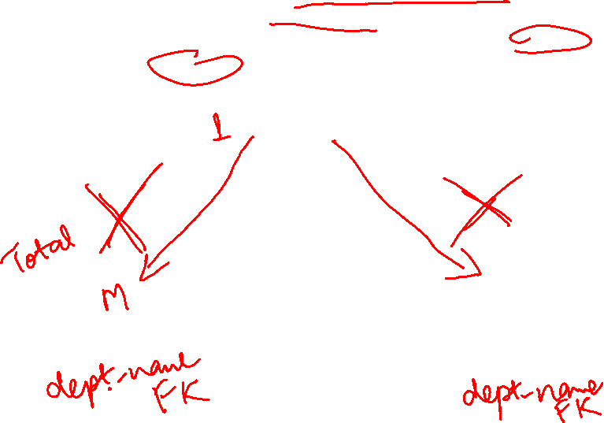
Mapping Many-to-one Relationships
Many-to-one and one-to-many relationship sets that are total participation on the many-side can be represented by adding an extra attribute to the “many” side, containing the primary key of the “one” side
Example: Instead of creating a schema for relationship set inst_dept, add an attribute dept_name to the schema arising from entity set instructor

Slide 52
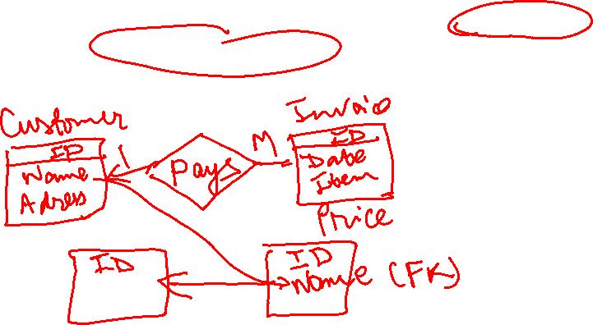
Mapping one-to-one Relationships
For one-to-one relationship sets, either side can be chosen to act as the “many” side
That is, extra attribute can be added to either of the tables corresponding to the two entity sets
Note: It will be easier to understand if we say that the “extra attribute” relates to the concept of a foreign key
Notes:
52

Slide 53
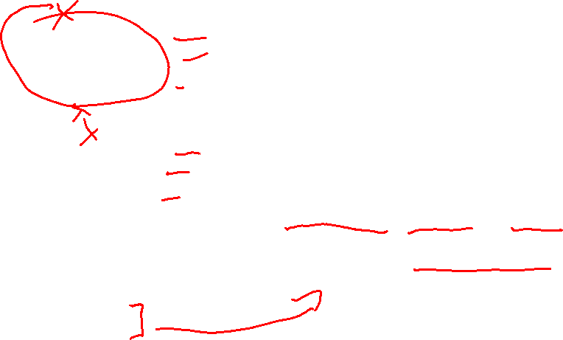
Composite and Multivalued Attributes
Composite attributes are flattened out by creating a separate attribute for each component attribute
Example: given entity set instructor with composite attribute name with component attributes first_name and last_name the schema corresponding to the entity set has two attributes name_first_name and name_last_name
Prefix omitted if there is no ambiguity
Ignoring multivalued attributes, extended instructor schema is
instructor(ID, first_name, middle_initial, last_name, street_number, street_name, apt_number, city, state, zip_code, date_of_birth)
Notes:
53

Slide 54
Composite and Multivalued Attributes
A multivalued attribute M of an entity E is represented by a separate schema EM
Schema EM has attributes corresponding to the primary key of E and an attribute corresponding to multivalued attribute M
Example: Multivalued attribute phone_number of instructor is represented by a schema: inst_phone= ( ID, phone_number)
Each value of the multivalued attribute maps to a separate tuple of the relation on schema EM
For example, an instructor entity with primary key 22222 and phone numbers 456-7890 and 123-4567 maps to two tuples: (22222, 456-7890) and (22222, 123-4567)
Notes:
54

Slide 55
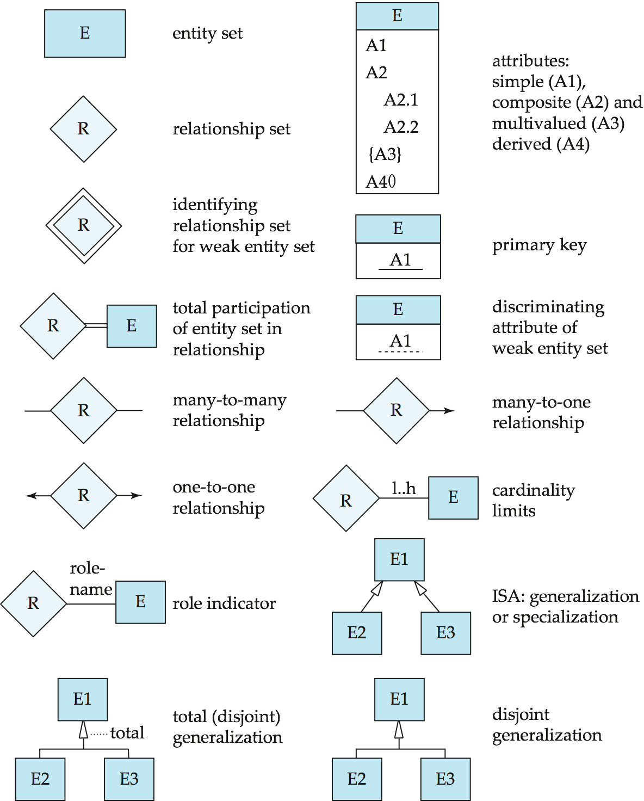

Summary of Symbols Used in E-R Notation

Slide 56

Symbols Used in E-R Notation (Cont.)

Slide 57

Alternative ER Notations
Chen, IDE1FX, …

Slide 58

Alternative ER Notations
Chen IDE1FX (Crows feet notation)

Slide 59
ERD Videos
ERDs: https://www.youtube.com/watch?v=-fQ-bRllhXc

Slide 60
Case study - ERD
You have just been hired as a consultant for a big airplane manufacturer. Impressed by your background in databases, they want you to completely redesign their database system. Talking with the people in the company, you get the following information:
- The database contains information about employees, factories and parts.
- Each employee has a social security number (SSN), name and salary. An employee is uniquely identified by his or her SSN.
- Each factory has an id, name and a budget. The id uniquely identifies a factory.
- Each part has an id and a name. The id uniquely identifies a part.
- Each employee works in only one factory, a factory can employ many employees.
- Each part is manufactured in at least one factory. A factory can produce many different parts.

Slide 61
Case study - ERD

Slide 62
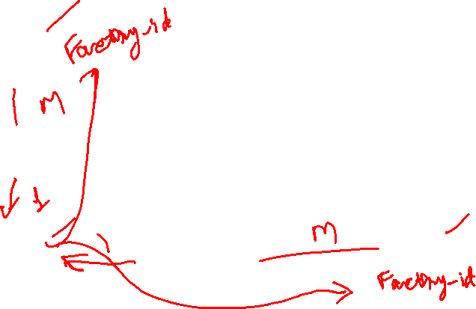
ERD - Answer
Employee
Ssn
Name
Salary
Works In
Factory
Factory_id
Name
Budget
Manufactured
Parts
Part_id
Part_name

Slide 63
Class Exercise - Example 1
Draw an ERD for the following scenario:
A customer can place many orders; an order may be placed by one customer only
Convert ERD to relational schema

Slide 64
Class Exercise - Example 2
A dealer can deal with many manufacturers, and a manufacturer can deal with many dealers.
Dealers can sell many vehicle models and vehicle models can be sold by many dealers.
Manufacturers can make many vehicle models and a vehicle model can be made by only one manufacturers.
Draw an ER diagram that captures the preceding information
Convert ERD to relational schema

Slide 65
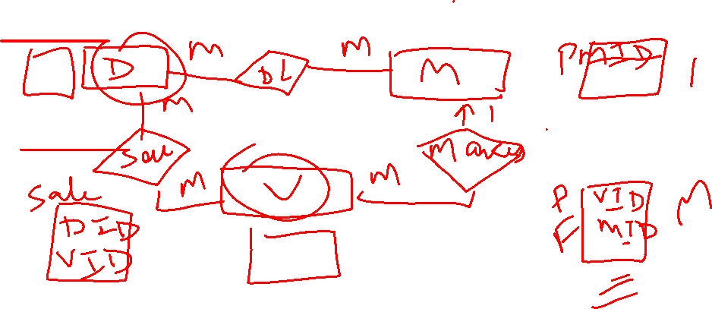
Class Exercise - Example 2
A dealer can deal with many manufacturers, and a manufacturer can deal with many dealers.
Dealers can sell many vehicle models and vehicle models can be sold by many dealers.
Manufacturers can make many vehicle models and a vehicle model can be made by only one manufacturers.

Slide 66
Class Exercise - Example 3
A department employs many employees, but each employee is employed by one department.
A division operates many departments, but each department is operated by one division.
An employee may be assigned many projects, and a project may have many employees assigned to it.
One of the employees manages each department, and each department is managed by only one employee.
One of the employees runs each division, and each division is run by only one employee.
Draw an ER diagram that captures the preceding information
Convert ERD to relational schema

Slide 67
Example 4
Construct ER diagram for a car insurance company where:
Customers own one or more cars each
Each car is associated with zero to any number of recorded accidents.
Each insurance policy covers one or more cars, has one or more premium payments associated with it.
Each payment is for a particular period of time, and has an associated due date, and the date when the payment was received.
Draw an ER diagram that captures the preceding information
Convert ERD to relational schema

Slide 68
Class Exercise - Example 5
Notown Records has decided to store information about musicians who perform on its albums (as well as other company data) in a database.
Each musician that records at Notown has an SSN, a name, an address, and a phone number.
Each instrument used in songs recorded at Notown has a unique identification number, a name, and a musical key.
Each album recorded on the Notown label has a title, a copyright date, a format, and an album identifier.
Each song recorded at Notown has a title and an author.
Each musician may play several instruments, and a given instrument may be played by several musicians.
Each album has a number of songs on it, but no song may appear on more than one album.
Each song is performed by one or more musicians, and a musician may perform a number of songs.
Each album has exactly one musician who acts as its producer. A musician may produce several albums, of course.
Draw an ER diagram that captures the preceding information
Convert ERD to relational schema

Slide 69
Example 6
A chain of pharmacies has offered you a free lifetime supply of medicine if you design its database. Here’s the information that you gather:
Patient records include an SSN, name, address, and age.
Doctor records include SSN, name, specialty, and years of experience.
Each pharmaceutical company is identified by name and has a phone no.
For each drug, the trade name and formula must be recorded. Each drug is sold by a given pharmaceutical company, and the trade name identifies a drug uniquely from among the products of that company. If a pharmaceutical company is deleted, you need not keep track of its products
Each pharmacy has a name, address, and phone number.

Slide 70
Example 6 (continued)
Every patient has a primary physician. Every doctor has at least one patient.
Each pharmacy sells several drugs and has a price for each. A drug could be sold at several pharmacies with different price.
A doctor could prescribe one or more drugs for several patients, and a patient could obtain prescriptions from several doctors.
Each prescription has a date and a quantity associated with it. You can assume that, if a doctor prescribes the same drug for the same patient more than once, only the last such prescription needs to be stored.
Pharmaceutical companies have long-term contracts with pharmacies. A pharmaceutical company can contract with several pharmacies, and a pharmacy can contract with several pharmaceutical companies. For each contract, you have to store a start date, end date, and the text of the contract.
Draw an ER diagram that captures the preceding information
Convert ERD to relational schema

Slide 71
Reading and Assignment

